Slide 1
Deep Learning
Traffic sign classification
with Data Augmentation
Matteo Anelli
José Manuel Pérez Ricote

Slide 2
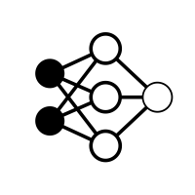




Problem
Statement
MLP
Number of labels → 43

Slide 3
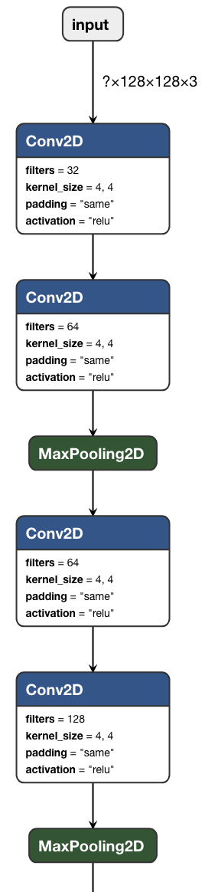
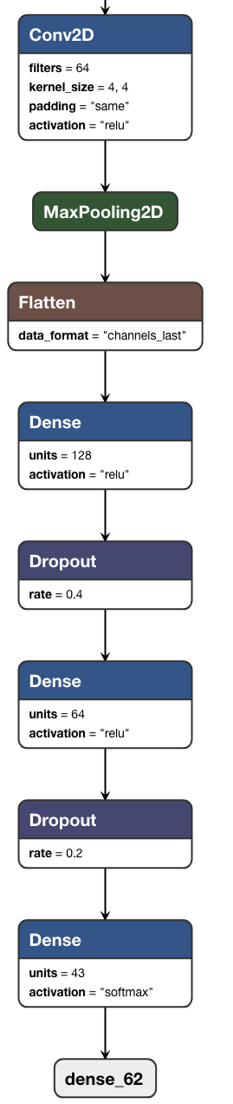
Network Architecture
Types of layers:
Convolutional: 5 layers of 32, 64, 64, 128, 64 of output space dimensionality, respectively.
Max2DPool: 2 layers with size equal to 2.
Flatten: 1 layer between CNN and ffNN.
Dense: 3 different layers.
Dropout: 2 dropout layers in ffNN part.

Slide 4

Image Data Generator
ImageDataGenerator function is modified, compared to given one:
width_shift_range, height_shift_range and shear_range are deleted.
rotation_angle is added with a value of 15 degrees.
zoom_range value is reduced from 0.2 to 0.1
Given ImageDataGenerator
New ImageDataGenerator

Slide 5
Image resizing
At first, the sign images are divided in 224x224 pixels.
We select as possible sizes 16, 32, 64 and 128 pixels, apart from default 224 pixels.
The results are the following ones:
For 16 pixels: Accuracy = 89.47%, Time (CNN) = 0.0943 seconds.
For 32 pixels: Accuracy = 96.12 %, Time (CNN) = 0.1331 seconds.
For 64 pixels: Accuracy = 95.29 %, Time (CNN) = 0.4013 seconds.
For 128 pixels: Accuracy = 95.56 %, Time (CNN) = 1.3511 seconds.
For 224 pixels: Accuracy = 86.15 %, Time (CNN) = 3.1119 seconds.

Slide 6

Hyperparameters Optimization
Number of epochs → 200
Learning Rate → 3e-4
Epsilon → 1e-7
Decay → 1e-6
Minibatch size → 16
Dropout → Only in dense layers

Slide 7
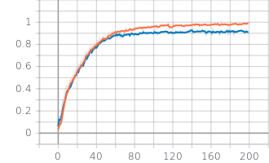
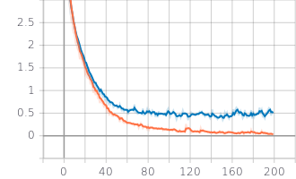
Performance
Accuracy
Loss Function
Training
Validation
Validation
Training
Final Test Accuracy → 0.9612
Final Loss Function → 0.2547
Final Time → 0.1331 seconds

